Slide 1
Input Combos
Gerard Marcos Freixas

Slide 2

INDEX
INDEX
Introduction
Presentation blocks
What is a combo?
Block I: Deeping into the subject
Combo differentiation
Time dependency
Immediate and holding input
Degree of freedom
Definiton & input scheme
Block II: Code structure
Input storage
Memory management
The implementation in-depth
Code exercises
Extra concepts

Slide 3
1. INTRODUCTION

Slide 4



1.1. Presentation blocks
1. Introduction
Block I: Theory
Block II: Code

Slide 5

1.2. What is a combo?
1. Introduction
Definition by wikipedia:
Combo: set of actions performed in sequence, usually
with strict timing limitations, that yield a significant benefit
or advantage.
Do you agree or disagree?

Slide 6

2. BLOCK I: DEEPING INTO THE SUBJECT

Slide 7
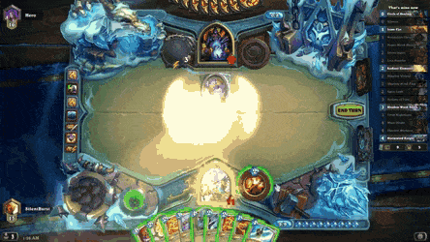
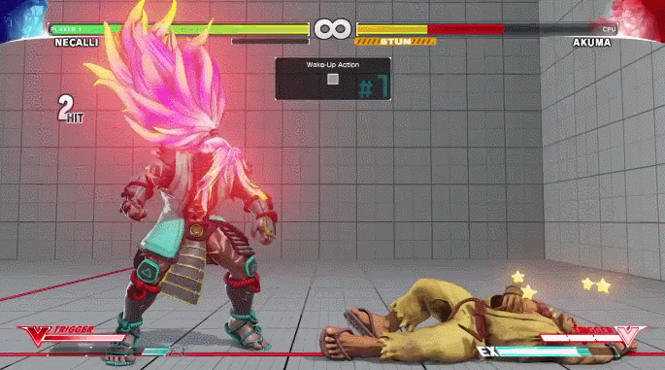
2.1. Combo differentiation
2. Deeping into the subject
Notice the difference?
1)
2)

Slide 8

2.1. Combo differentiation
2. Deeping into the subject
First main factor: the time between inputs
1) Use of timing: NO
2) Use of timing: YES

Slide 9

2.1.1. Time dependency
2. Deeping into the subject
Time-independent
Single input
Time-dependent
Single input
Parallel input
Single & Parallel input

Slide 10



2.1.2. Immediate and holding input
2. Deeping into the subject
Second main factor: the time pressing a key/button
Button pressed
+ Frenzy, Action
Immediate
Holding
- Frenzy, Action

Slide 11


2.1.3. Degree of freedom
2. Deeping into the subject
Third main factor: the freedom of the inputs chain
Input degrees of freedom
Determined chains
Checked chains
Defined
Undefined
Determined chains
Checked chains

Slide 12
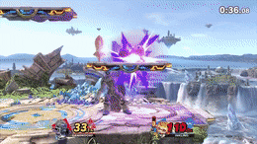
2.1.4. Definition & input scheme (I)
2. Deeping into the subject
The ideal definition:
Combo: set of actions performed in sequence, with or without strict timing limitations, that yield a significant benefit or advantage.

Slide 13
2.1.4. Definition & input scheme (II)
2. Deeping into the subject
Think about your type of input(s) you want in your videogame.
Combo
Time-independent
Time-dependent
Single input
Single input
Parallel input
S & P input
Immediate button pressed
Holding button pressed
Defined freedom
Undefined freedom

Slide 14
2. BLOCK II: CODE STRUCTURE

Slide 15

3.1. Input storage (I)
3. Code structure
Keep in mind: we need to leave in evidence the buttons/keys we press!
Input tracking

Slide 16

3.1. Input storage (II)
3. Code structure
Use of containers.
Vector
List
Queue
Tree
Store the combos input events and the combos.
Acts like a buffer. We store the actual user input events.

Slide 17
3.1. Input storage (III)
3. Code structure
The combos need to be previously defined by us. Set up by xml.
We will check if the array of the combo exists in our current buffer.

Slide 18




3.1. Input storage (IV)
3. Code structure
Sample defined combo
Buffer #1
Buffer #2

Slide 19
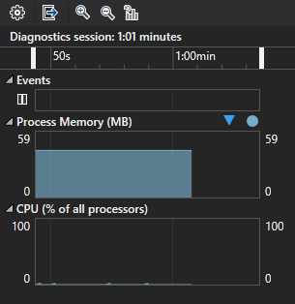
3.2. Memory management (I)
3. Code structure
Note: dynamic memory!
We can’t really save all the inputs during all the time.
We need some rules to know when to delete them.

Slide 20
3.2. Memory management (II)
3. Code structure
When we will delete the input events in the buffer?
When a single input event lasts more than the maximum time allowed.
Delete this event
When the user completes a combo.
Delete all the buffer elements

Slide 21
3.3. The implementation in-depth (I)
3. Code structure
Application module
j1InputCombos
std::list<InputEvent*> user_input_events;
Main elements
Buffer
std::vector<InputCombo*> combos;

Slide 22
3.3. The implementation in-depth (II)
3. Code structure
InputEvent class
j1PerfTimer timer;
Crucial role in the class constructor!
Main elements
CUSTOM_EVENT_TYPE type;
InputEvent(CUSTOM_EVENT_TYPE type, bool use_of_timer = false);
Only use in the buffer

Slide 23
3.3. The implementation in-depth (III)
3. Code structure
ComboEvent class
std::vector<InputEvent*> vector_item;
Main elements
COMBO_NAME combo_name;

Slide 24
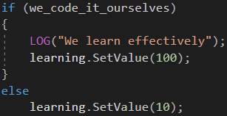
4. CODE EXERCISES

Slide 25
TODO 1
4. Exercises
“Create another combo. Place any inputs you want! Guess what the attribute "name" of the combo should be. Investigate through the code for some clues. We can add another input_event type called "kick".”
Location: Input_Combos/Config/config.xml

Slide 26
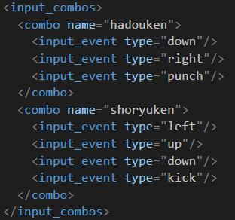
TODO 1 - Solution
4. Exercises

Slide 27
TODO 2
4. Exercises
“We need to fill every combo creation. Think about where we can push every input event to the combo. Hint -> we need to call a function located in InputCombo.h/.cpp. Notice another hint in the code.”
Location: Input_Combos/Modules/j1InputCombos.cpp

Slide 28
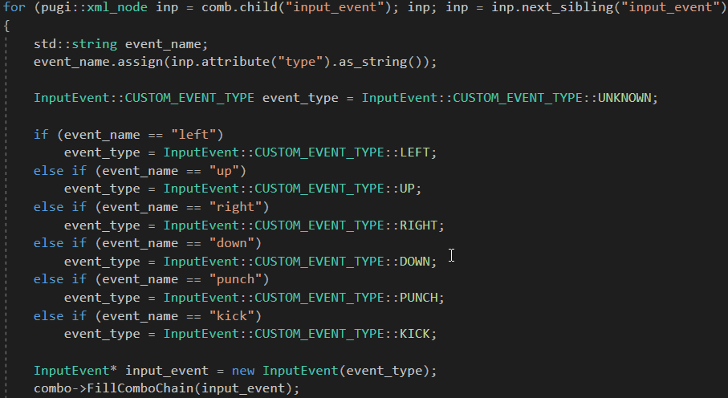
TODO 2 - Solution
4. Exercises

Slide 29
TODO 3
4. Exercises
“We need to check and choose what keys we press (depending on the config.xml). If we press one of these keys, push this event to the user_input_events std::list. Hint -> Usage of ReturnEvent(parameter) function.”
Location: Input_Combos/Modules/j1InputCombos.cpp

Slide 30
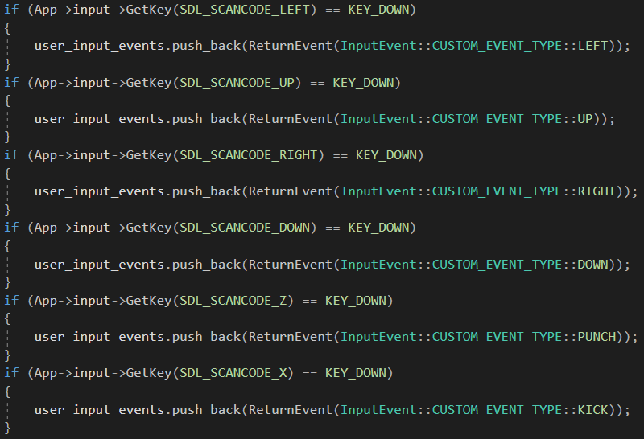
TODO 3 - Solution
4. Exercises

Slide 31
TODO 4
4. Exercises
“First of all, uncomment the following block of code. This function deletes any input event that there is in the buffer Think about what should be the condition. Also, we need to place another line of code inside the condition block *. Hint #1 -> Remember what I said about the buffer? (What was the condition to delete an element). Hint #2-> There is a macro you need somewhere...”
Location: Input_Combos/Modules/j1InputCombos.cpp

Slide 32
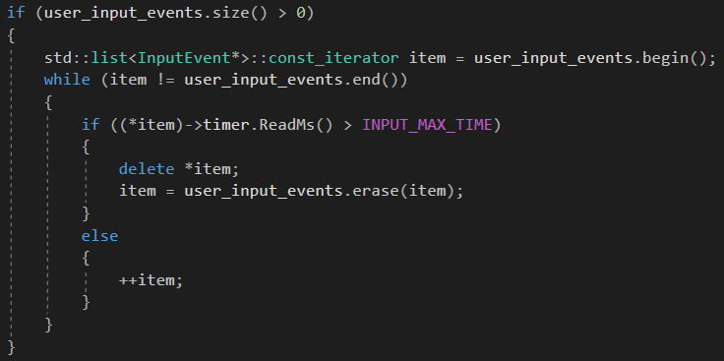
TODO 4 - Solution
4. Exercises

Slide 33
TODO 5
4. Exercises
“Set the player animation. There are two lines of code you need to place somewhere here... No hints this time.”
Location: Input_Combos/Modules/j1InputCombos.cpp

Slide 34
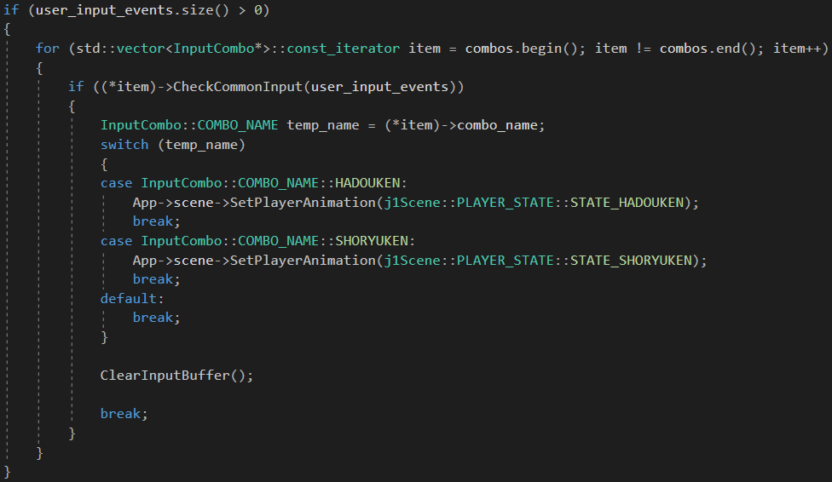
TODO 5 - Solution
4. Exercises

Slide 35
TODO 6
4. Exercises
“Guess what we need to do here. Simple function call!”
Location: Input_Combos/Modules/j1InputCombos.cpp

Slide 36
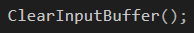
TODO 6 - Solution
4. Exercises

Slide 37

Homework !
4. Exercises
Investigate thoroughly all the code I implemented. See the relations between the scene and the module. Play with the classes I created, called:
User_Input/InputEvent.h
User_Input/InputCombo.h
Modules/j1InputCombos.h

Slide 38
5. EXTRA CONCEPTS

Slide 39
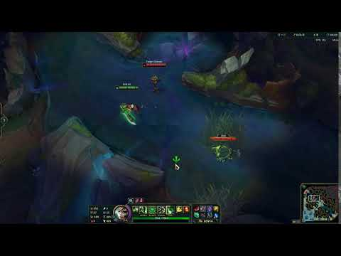
Animation canceling & actions or colliders (I)
5. Extra concepts
In our code we can cancel our animations by using another one. Good example in League of Legends:

Slide 40
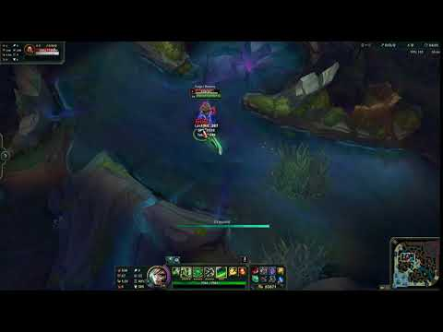
Animation canceling & actions or colliders (II)
5. Extra concepts
Animation cancelling is very rewarding but also very risky. Watch out for the actions and colliders! Another example:

Slide 41

Improvements
5. Extra concepts
Controllers
Colliders & actions
Overall structure

Slide 42
Thank you for your attention

